Slide 1
The Coca-cola Company’s
Common Code for MQ Series
“Fast track”
User’s tutorial

Slide 2
Welcome to “Fast Track”
“Fast track” is a short, quick-paced tutorial that provides all of the key information needed to transfer data files using MQ series by IBM in a 30 minute presentation.
“Fast track” assumes that …
  You know nothing about MQ series.
  You need to move files in a production job at TCCC.
  The new processing was probably due YESTERDAY so …
  you have no time for anything but the essentials.
  Using the file transfer protocol (FTP) seems simpler and better than using
  MQ series, and you are already familiar with using FTP.

Slide 3
The Scope of“Fast Track”
“Fast Track” covers TCCC’s custom interface to MQ Series,
which is known as the MQ Series Common Code.
“Fast Track” covers the most common usage of the Common Code,
which is:
  Cross Platform File Transfers
  Integration with a legacy application with SAP.
“Fast Track” does not discuss the Common Code’s support for:
  Management of exceptional and/or unusual conditions such as Batch Restarts
  Transactional messaging capabilities
  Usage in multiple National Settings and/or Processing Platforms.
  Various installation-specific, operational standards and processing requirements.

Slide 4
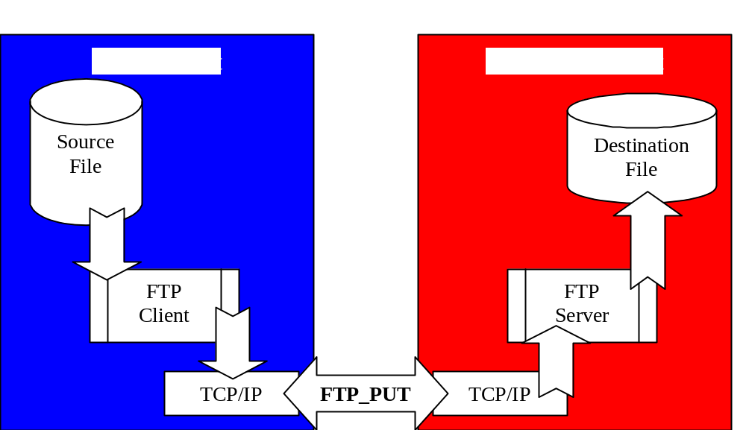
FTP File Transfers
Since we are familiar with FTP, let’s use it as a comparative basis for learning about the Common Code.
How do I transfer a file with FTP ?.
Sign-onto the
source system
Sign-on to the destination system
Use an FTP program to Issue a PUT.

Slide 5
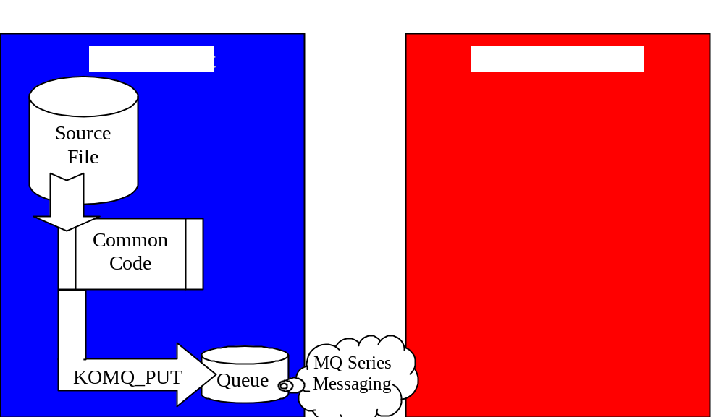
MQS Common Code File Transfers
How do I transfer a file with the Common Code for MQ Series ?.
Sign-on the source system
Use a Common Code program to Issue a PUT.
Behind the scenes a little MQ Series Messaging magic happens ...

Slide 6
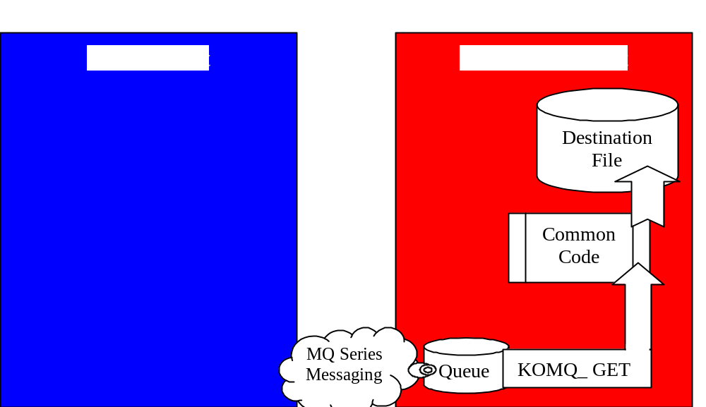
MQS Common Code File Transfers
and then ...
Sign-on the destination system
Use a Common Code program to Issue a GET.

Slide 7
Similarities
In both cases:
No new programming is necessary for a human sender to transfer a file.
Transferring a file involves running an existing program on one computer,
which transfers a copy of the file to another computer.
A source file(s) must be created independent of the transfer process.
Specific Information is a pre-requisite for transferring a file:
  The Source machine
  The Name and Location of the Source file
  The Destination machine
Specific Access is a pre-requisite for transferring a file:
  Sign-on privileges on the Source and Destination machines
  Read access to the Source File
  Create and/or Write access to the Destination File

Slide 8
More Similarities
In both cases Automating a File Transfer process will require:
Process Design.
  Locations and Naming conventions for files on both systems ?
  How will the transfer file be created ?
  When and how frequently will the transfer process run ?
  What will trigger transferring the file ?
  What will trigger processing the file at the destination ?
  How will the transferred file be processed at the destination ?
  What are the potential failure points across the entire process ?
  How will errors be detected and resolved ?
New Programs, Scripts and/or Procedures.
  A Parameter file to hold the specifics of the process
  A Program to extract the source file
  A Script to execute the extract program and the transfer program
  Procedures for running the script and/or specifications for automated scheduling
  Procedures for resolving errors at all points-of-failure

Slide 9
Differences
File Transfer Protocol
Single Step Process
Synchronous file transfers
  All resources must be available at the same time for a transfer to occur. Senders must wait until the receiver is available and has time to complete.
No administrative pre-requisites to transfer files.
The Sender must have access to both machines.
After transmission errors, the sender must always retransmit the entire source file.
MQS Common Code
Two Step Process
Asynchronous file transfers
  Only local resources must be available for a transfer to occur. Senders can transfer files while the receiver machine is down.
Transfer resources and pathways must be predefined by administrative personnel.
The Sender needs access to only the source machine.
After transmission errors, the sender can restarting the PUT process where it left off.

Slide 10
Comparative Summary
File Transfer Protocol
Simplest possible approach
Implements somewhat more quickly
  No administrative coordination required
Is better suited for usage in
ad-hoc and non-automated scenarios
MQS Common Code
Is the most robust and fault tolerant approach for data transfers within automated processing.
  Assures delivery at the destination.
  Provides automated balancing.
  Provides National Language Support for International Users.
Is required by TCCC for all integration with SAP.

Slide 11
The MQS Common Code
MQS Common Code was specifically designed to:
  Simplify SAP integration with Legacy systems.
  Capitalize on our familiarity with using files for inter-system integration.
  Minimize the custom development necessary to integrate with SAP
MQS Common Code fulfills those design specifications by:
  Handling all of the details involved in separating the records of a file into a series of independent messages.
  Transferring those messages asynchronously through a network and determining when they have all arrived.
  Correctly reassembling messages in sequence, back into a single file on the destination machine.
  Accompanying your data file with a control file to enable verification on the destination system that ALL RECORDS of the ENTIRE file have been transferred, and providing Automated Balancing to perform this verification..

Slide 12
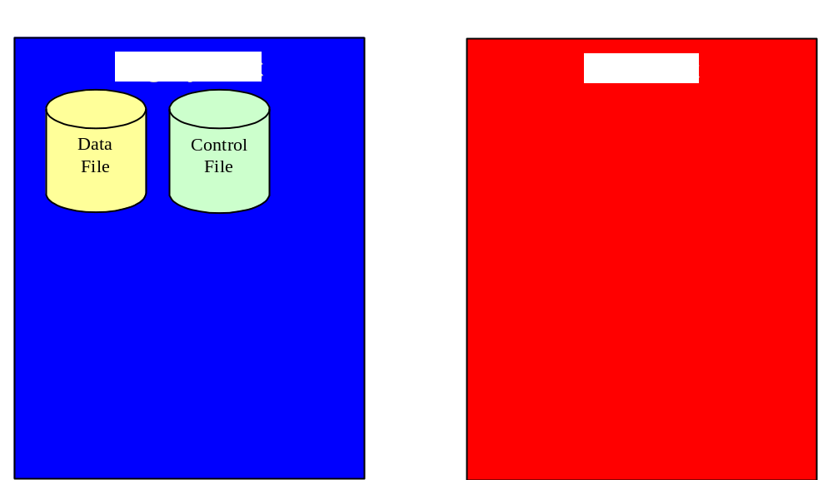
The Details of MQS Common Code
Now, lets go beyond WHAT the Common Code does, into HOW it does it!
The sender extracts a data file from the legacy system
The sender also constructs a control file, which contains a single record with a count of the records in the data file.

Slide 13
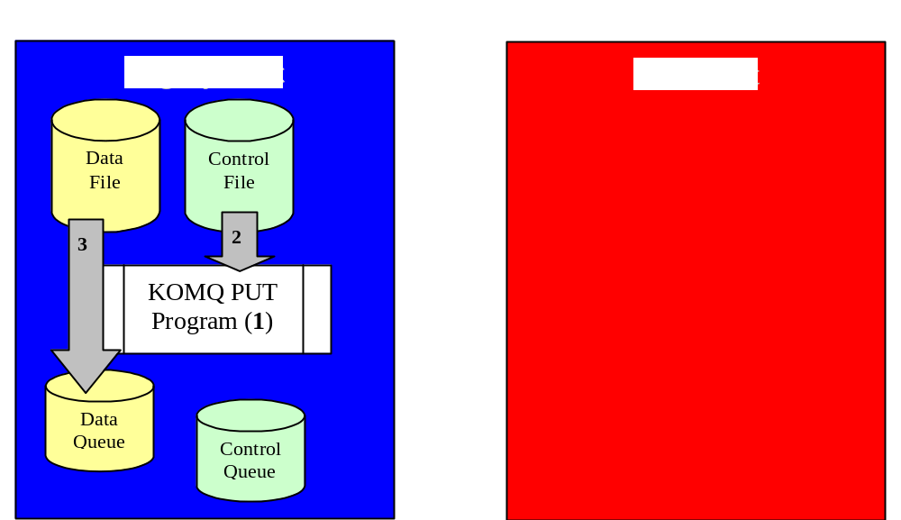
The Details of MQS Common Code
First, MQS Common Code PUT is run.
Second, KOMQPUT reads the control total from the control file
Third, All of the records from the data file are separated into independent messages and put in the data queue.

Slide 14
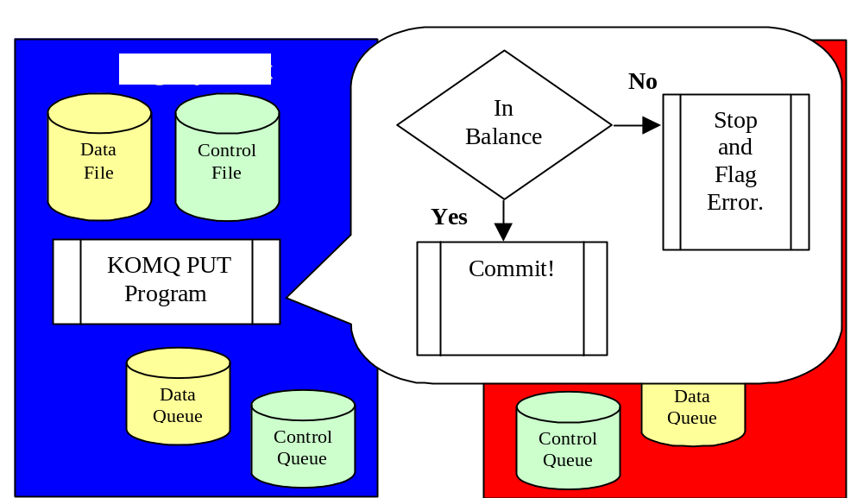
The Details of MQS Common Code
Automated Balancing
The number of records read from the Data file is compared to the totals field from the Control file..
On Balanced, the control record is written to the Control Queue and the batch is committed!
On Out-Of-Balance a rollback is issued and an Out-Of-Balance return code is set.

Slide 15
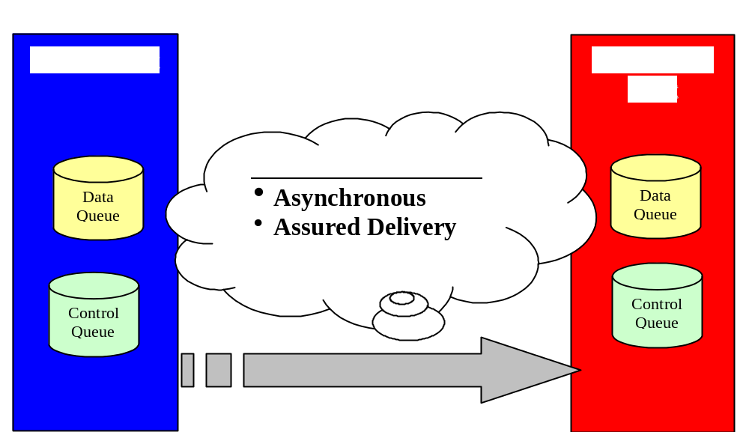
The Details of MQS Common Code
Once a batch is committed, MQ Series takes over.
But what does MQS really promise about delivery?
The messages will be delivered whenever the Destination Host is ready for them.
No messages will be lost in the process.

Slide 16
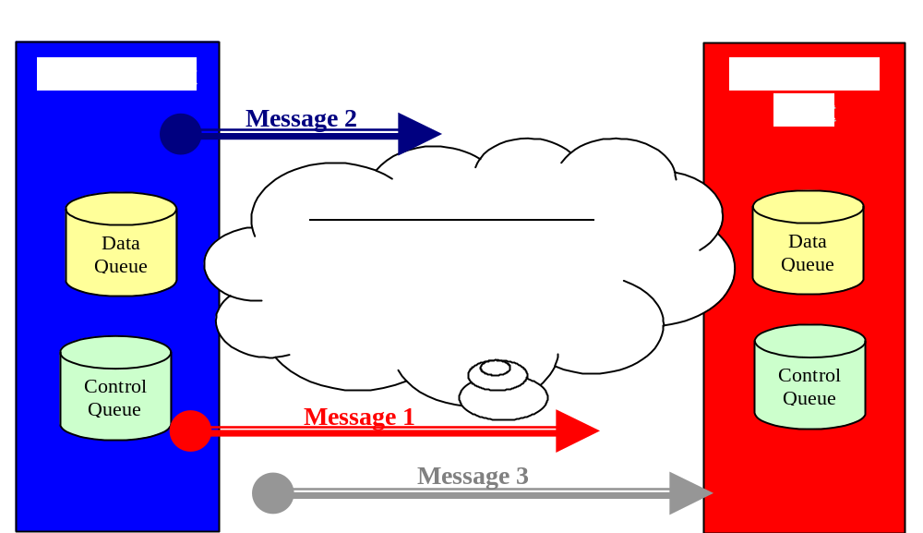
The Details of MQS Common Code
However, MQS makes NO PROMISES about?
When the messages will arrive.
Along which network connections the messages will travel.
Whether the messages will travel alone or together.
The order in which the messages will arrive at the destination.

Slide 17
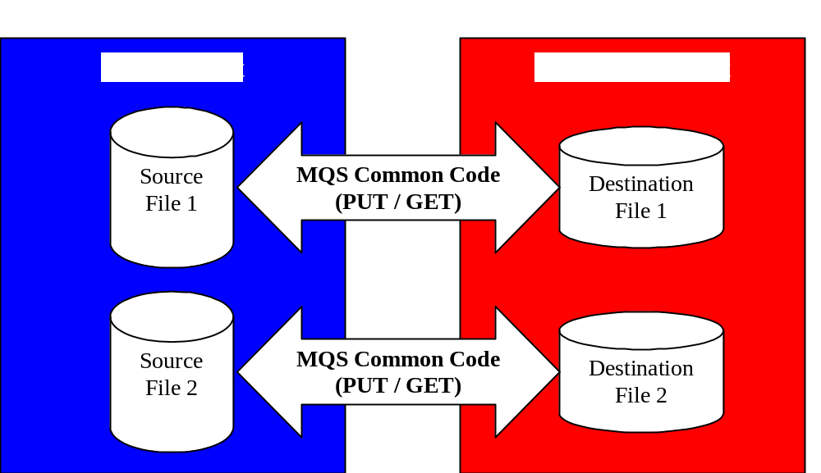
The Details of MQS Common Code
So, MQS Common Codes guarantees predictable file transfer behaviors:
Multiple concurrent file transfers will arrive as separate files.
A successfully retrieved (GET) file will contain all of the records sent, in the correct sequence.
A file will usually be available only after all of its records have arrived.

Slide 18
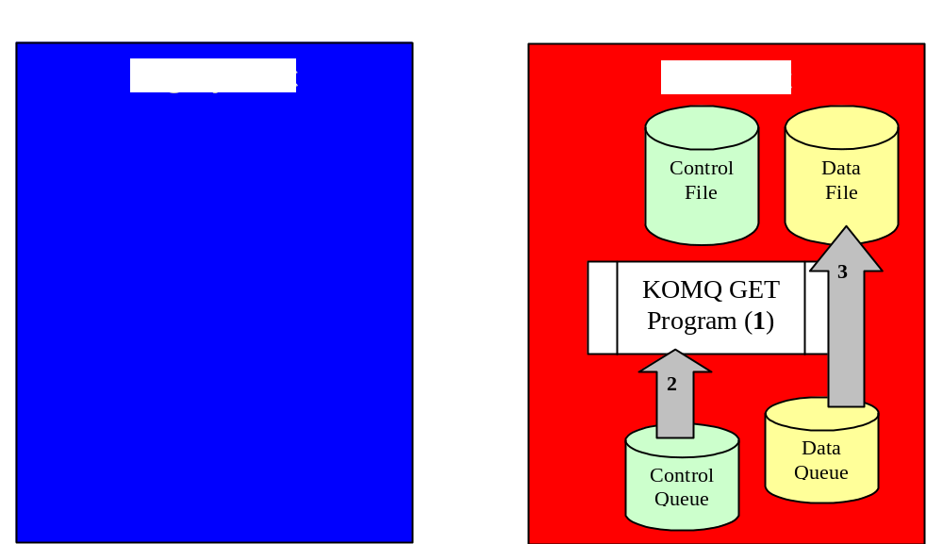
The Details of MQS Common Code
First, MQS Common Code GET is run.
Second, KOMQGET retrieves a Control record from the Control Queue.
Third when a record is found, the expected total is noted and all associated records for that file are transferred, in–order, from the Queue to a Data file on the host.

Slide 19
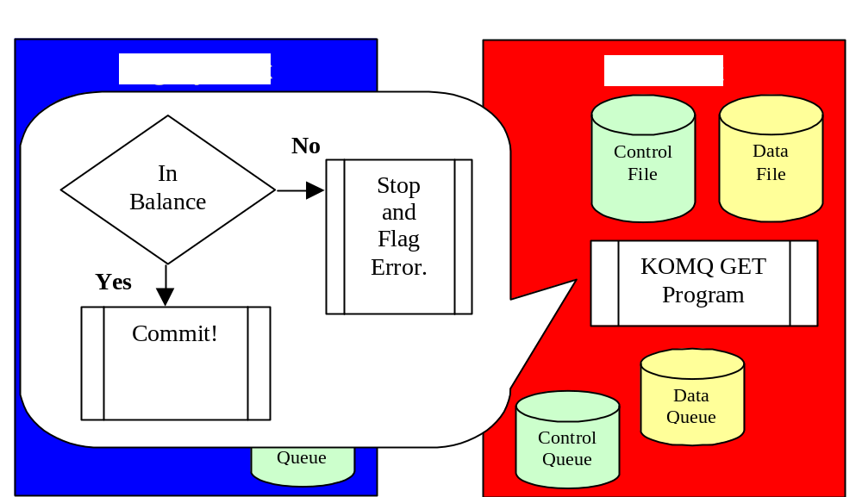
The Details of MQS Common Code
Automated Balancing
The number of records read from the Data queue is compared to the totals field from the Control queue..
On Balanced, the control record is written to the Control file and the batch is committed!
On Out-Of-Balance a rollback is issued and an Out-Of-Balance return code is set.

Slide 20
Queues and How We Use Them
You now have the essential information for transferring files using the MQS Common Code. However before you begin transfer processes, there is a little information concerning MQ Series Queues and the way we use them at The Coca-Cola Company that is very helpful.
A Queue is a container.
MQ Series Queue are a one-way street.
Queues come in Sets at TCCC

Slide 21
A Queue is a Container
To transfer files using MQ Series, we convert each of it records into a message and store it into a container called a Queue. A Queue ...
  must be defined before we can use it.
  is controlled with a single security profile.
  can hold the contents of many files at once.
  is defined with a maximum number of concurrent records.
    Consider how many records will be in each file.
    Consider how many concurrent files it will need to hold.
    If you don’t specify the usual default is 10,000 concurrent messages.
  is typically owned by a single application or portfolio at TCCC.

Slide 22

MQS Queues are a One-Way Street
An MQ Series queue connects one source with one destination and carries traffic in one direction. To transfer information between systems, we must define:
A remote queue on the Source host.
A local queue on the Destination host.
The connection between the Source and Destination
Implementing a bi-directional flow of information requires two sets of queues
One for outbound traffic and another one for inbound traffic.
Outbound Data
Inbound Data

Slide 23
Queues come in Sets at TCCC
At TCCC we have standardized a set of five related queues for each direction of traffic. Three of these five are currently required to implement file transfers.
Required Batch File Transfer Queues
  Data Queue ( Standard Name: USTCCCAA.[appname].QUEUE )
  Control Queue ( Standard Name: USTCCCAA.[appname].BATCNTL )
  Dead Letter Queue ( Standard Name: USTCCCAA.[appname].DLQ )
Additional Queues for Transactional Processing
  Error Queue ( Standard Name: USTCCCAA.[appname].ERR )
  Reply Queue ( Standard Name: USTCCCAA.[appname].REP )

Slide 24
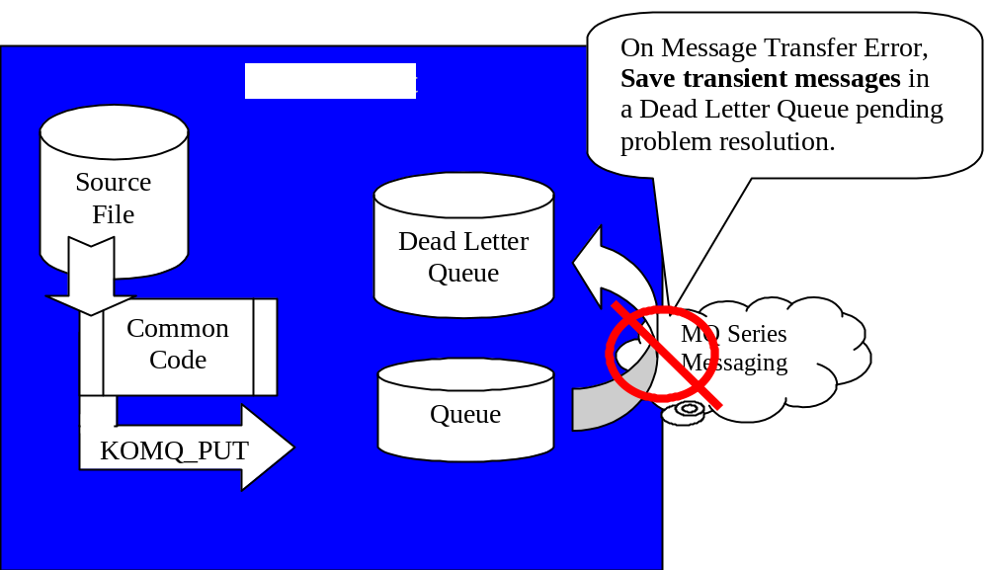
Your file can become a Dead Letter!
You are familiar with the Data and Control Queues, but
What is a Dead Letter Queue?
After messages are put into a queue, MQ Series has promised not to lose them.
So .. If an error occurs while it moves them between systems it uses a Dead Letter Queue to keep its promise.

Slide 25
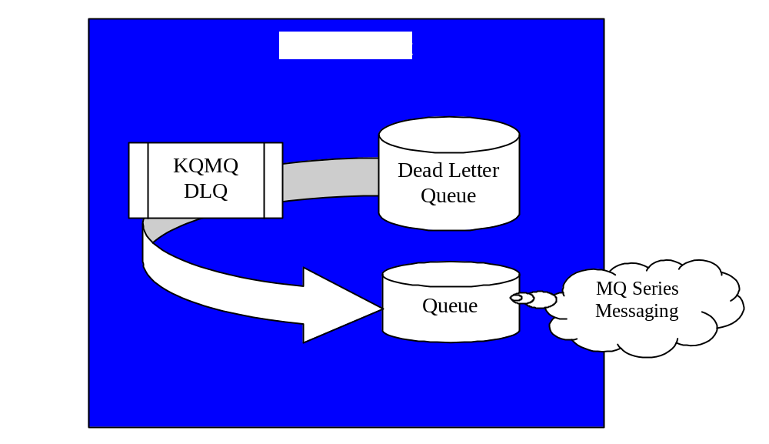
Your Job Concerning Dead Letters
What happens to messages in the Dead Letter Queue ?
They stay there, until the application that created them determines what to do with them.
If the original problem has been resolved, and they should be resent to their destination, …
there is a Common Code program, KQMQDLQ, you can use to transfer them back into a data queue and re-send them.

Slide 26
The Tasks At Hand ...
At this point, we hope that you have some pretty clear ideas about ...
How you can Transfer Files using the MQS Common Code.
What are MQ Series Queues and How We Use Them to Transfer Files.
Now, we would like to clarify some of the tasks that remain for each application designer in order to use the MQS Common Code.

Slide 27
Steps to using MQS Common Code
Analyze and Design the Integrated Transfer Process
  Request a copy of the MQS Common Code User’s Documentation
  Determine the Source and Target Systems
  Establish Application Naming Conventions
    Queues
    Batch Headers
  If multiple file formats are to be transferred …
    Establish a Queue Utilization Approach
  Establish a File Management Approach
    How will multiple file formats be segregated
    Establish a File Archiving/Removal strategy
  Establish the related Volumetric and Scheduling Information
    Maximum number of records in a file
    Record length of the files.
    Queue Depth requirements.
    Transfer frequencies.

Slide 28
Steps to using MQS Common Code
Request Definition of Queues
  Use the request forms from the User’s Documentation Appendix
  Request definition of Queues
    Separate requests for both Source and Destination machines.
      Request a “Remote” queue definition for the Source machine
      Request a “Local” queue definition for the Destination machine
    Request a separate set of Queues for each transfer direction.
      Queues are uni-directional.
      A bi-directional data flow requires a separate queue for each transfer direction.
    Send requests to the MQ Series support team for the specific platform.
      OS/390 Isaiah Rosenblit
      AS/400 Scott Murray
      AIX Debbie Granger

Slide 29
Steps to using MQS Common Code
Prepare Your Parameter Files
  Determine the common processing Parameters
    Does the record length necessitate blocked file processing?
    I/O Buffer Length
    Batch Interval
  PUT processing Parameters
    Queue Manager Name
    Queue Names for the Sending Machine
    File Names and locations for the Sending Machine.
    Batch Header value for each File Format.
  GET processing Parameters
    Queue Manager Name
    Queue Names for the Receiving Machine
    File Names and locations for the Receiving Machine.
    Must NOT contain a BATCH HEADER keyword.
  Dead Letter processing Parameters
    Queue Names for the Sending Machine
Note: Queue Names may or may not correspond between the sending and the receiving machines.
The relationship between queues is established by definition not by naming conventions.

Slide 30
Steps to using MQS Common Code
Prepare a Script for PUT, GET and Dead Letter processing.
  A script defines the actual invocation of the transfer program as well as any
  pre/post transfer processing that is necessary.
    Each platform refers to these scripts using different nomenclature
      OS/390 JCL, PROCs, CLISTS, and REXX
      AS/400 CL, and REXX
      Windows Batch files (.BAT), Perl, VBScript, Jscript, Host Scripting
      Unix / AIX Korn Script, Bourne Script, and Perl
Unit test all of your scripts.
From your failure point analysis, construct a comprehensive integration test plan.

Slide 31
Steps to using MQS Common Code
Conduct a technical walk-through in which you review your:
(If possible, it is recommended that you include the MQS Common Code support staff.)
  Parameter Files
  Scripts
  Failure Point Analysis
  Test Plans
Execute your test plan.
Prepare and execute an implementation plan.

Slide 32
Your Questions and Ideas
We hope this presentation has helped get you started and also stimulated some further questions and ideas.
To provide you with a greater degree of detail here is our current documentation concerning the MQS Common Code .
MQS Common Code Documentation
As far as other questions, ideas, and/or feedback on this presentation;
please feel free to contact our MQS Common Code support team.
  Dan Creager, 404-676-6129
  Sandra Beem, 404-676-6240
  Tamara Huston, 404-676-7943

